Slide 1
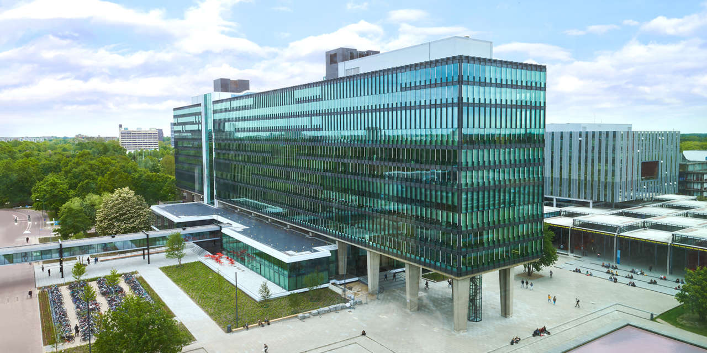
Solution and Risk Management
16/03/2023
Elham Honarvar, Project manager
Mechatronic System Design
Autonomous Referee

Slide 2
Scope of the project
For the starting point to set an integration delivery, a corner kick game start procedure will be used because:
The procedure can be extended for all the rules
Camera technology is trustable and hardware is reachable.
Implementation has a direct effect on the game, since the human referee does not measure distances during a real match.
It is extendable and reusable

Slide 3
Progress of the project
Needs
Mission
Requirements
Flow Diagram - Game States
Additional Constraints
Approach Search
Feasibility of different design solution
Technologies Search
TRL of different Technologies
Logical Decomposition
Define Scope
PoC
Solution Design

Slide 4
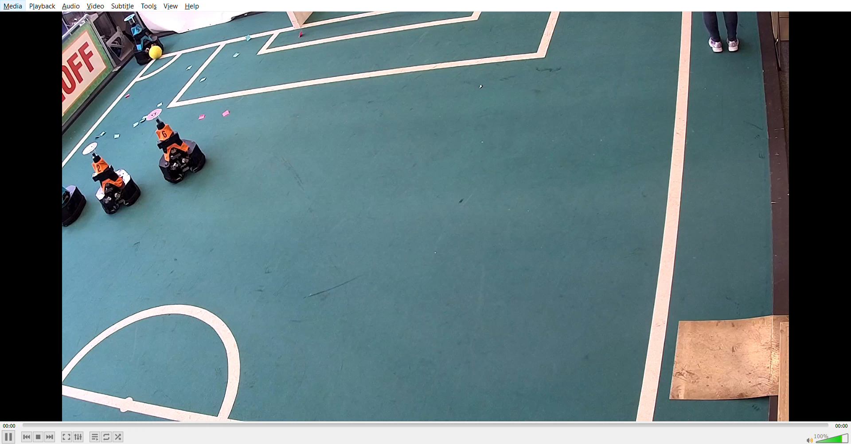
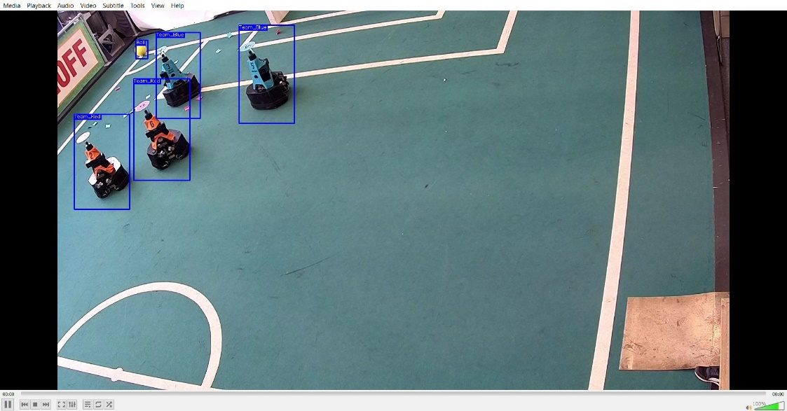
The progress of the algorithm
Preparing the dataset
Training the model
Providing the top view of the field using transformation
Finding the distance of the robots using bird eye view method

Slide 5
Risk Management
Risk | Domain | How | Severity
Hacking the cameras | Privacy & Security | Our cameras are potentially vulnerable to cyberattacks that can execute a variety of harmful actions that can have impact on the judgment of the referee. | 3
Hacking the referee system | Privacy & Security | Our referee system is potentially vulnerable to cyberattacks that can execute a variety of harmful actions that can have impact on the judgment of the referee. | 3
Data storage privacy | Privacy & Security | There are chances that we lose the stored data and the history of the game. | 3
Blocking camera's vision by an obstacle | Quality & Reliability | If by chance anything blocks the camera's vision, then the refree might miss some imporant details and not being able to make fairfull decision. | 2
Fading out the color of the stickers around the football field | Quality & Reliability | If the labels in the field faded out, then it might be difficult for our referee to detect the lines and make decision. | 3
Camera malfunction | Quality & Reliability | Any functional issues in the camera, can cause a delay in the refree's decision. | 5
Light condition | Quality & Reliability | If the light condition of the field is not desired, then the autonomous referee might have issue for detecting the lines and make a decision. | 3
communication problem between autonoum & human refree | Technical Performance | There will be a delay in referee's decision making, if there are any communication issues between autonomous referee and human referee. | 4
Calibration & tuning of image processing tech | Technical Performance | The accuracy of the current algorithm depends on the method which is used for collibration of the field. | 5
Low confidence on object detection ( detecing between ball,team 1 robot, team 2 robot) | Technical Performance | Since the dataset has been made by us, the detection accuracy may not be accurate.
Lower flexibility of code to different robot players | Technical Performance | If there are any changes in robot's color or type, our code is not flexible to adjust it in short term. | 8

